Slide 1
BREAD AND PASTRY PRODUCTION
RONALD PAUL GEBERTAS BRIONES JR.

Slide 2
DEFINITION OF TERMS
Baking – the process of cooking food by indirect heat or dry heat in a confined space as in heated oven using gas, electricity, charcoal, wood, or oil at the temperature from 250 ºF – 450 ºF
Batter – a flour mixture that can be stirred or poured
Discard – to get rid of as of being further use
Dough – a flour mixture that can be rolled or kneaded.

Slide 3
BREAD AND PASTRY PRODUCTION
is a technical-vocational program that develops the skills of students in preparing and producing bakery/pastry products, cakes and desserts.

Slide 4
BREAD AND PASTRY PRODUCTION: TOOLS AND EQUIPMENT
CLASSIFICATION OF TOOLS
Baking Pans
Measuring Tools
Mixing Tools
Cutting Tools
Miscellaneous Tools
Decorating Tools

Slide 5
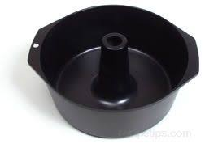
BAKING PANS
Tube Center Pan – deeper than the round pan, has a hollow center which is removable and used for baking chiffon cakes.

Slide 6
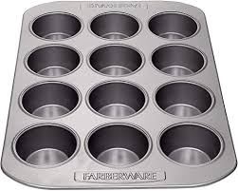
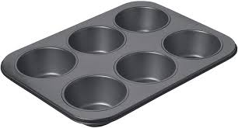
BAKING PANS
Muffin Pans – has 6 or 12 formed cups for baking muffins and cupcakes.

Slide 7
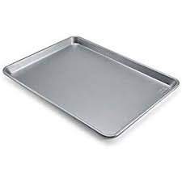
BAKING PANS
Jelly Roll Pan – a hollow rectangular pan used for baking cake rolls.

Slide 8
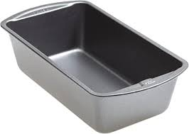
BAKING PANS
Loaf Pan – used for baking loaf bread.

Slide 9
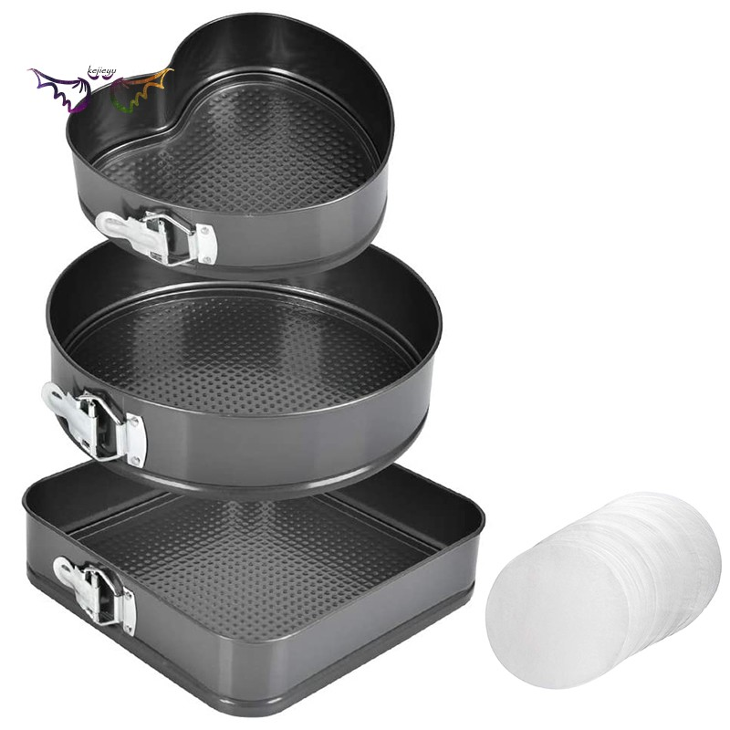
BAKING PANS
Cake Pans – comes in different shapes used as container of batter for cakes.

Slide 10
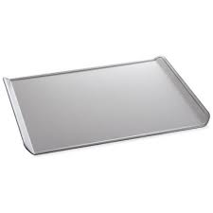
BAKING PANS
Cookie or Baking Sheet – is a flat aluminum sheet used for baking cookies.

Slide 11
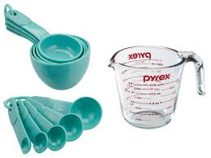
MEASURING TOOLS
Measuring Cups – are used to measure dry and liquid ingredients.
Measuring Spoons – used to measure small amount of ingredients.

Slide 12
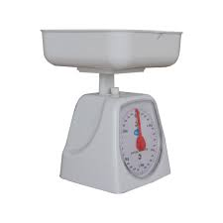
MEASURING TOOLS
Weighing Scale – used to measure large quantities of ingredients.

Slide 13
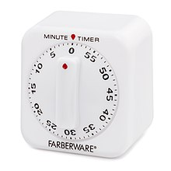
MEASURING TOOLS
Timer – monitors the baking time, and rising the dough.

Slide 14
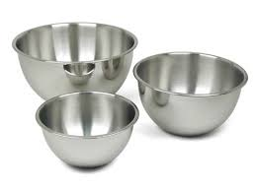
MIXING TOOLS
Mixing Bowls – comes in various sizes with sloping sides to ease mixing.

Slide 15
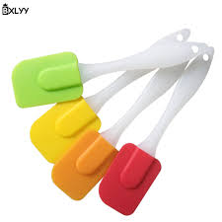
MIXING TOOLS
Rubber Scraper – a pliable rubber or plastic used to scrape or remove remaining ingredients from the sides of the mixing bowls.

Slide 16
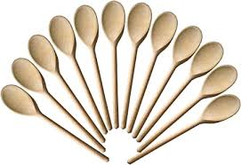
MIXING TOOLS
Wooden Spoons – used as mixing spoons.

Slide 17
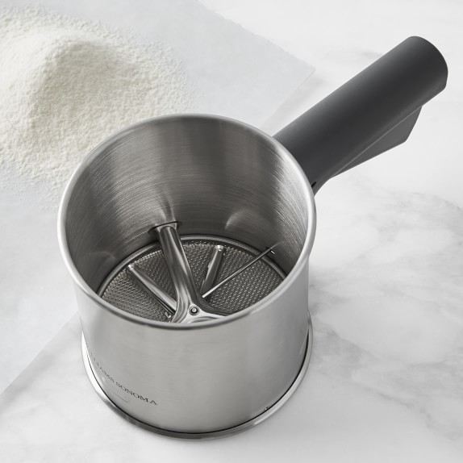
MIXING TOOLS
Flour Sifter – used for sifting and adding air to the flour and other dry ingredients.

Slide 18
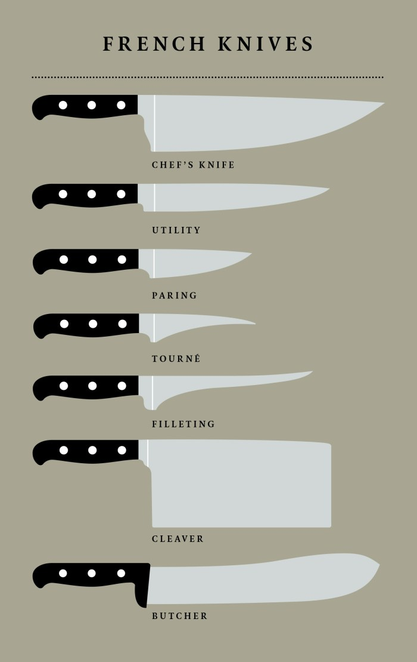
CUTTING TOOLS
Chef’s or French Knives – are all – purpose knives used for a variety of chopping, slicing, and mincing tasks.

Slide 19
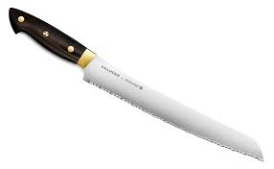
CUTTING TOOLS
Bread Knife – has a serrated edge that helped to cut bread or cake without crushing it

Slide 20
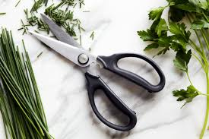
CUTTING TOOLS
Kitchen Shears – used for cutting dried fruits and vegetables fresh, fresh herbs and cutting pastry.

Slide 21
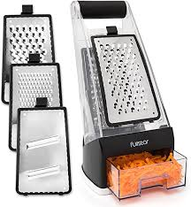
CUTTING TOOLS
Grater and Shredder – used to grate, shred or slice vegetables, fruits and cheese.

Slide 22
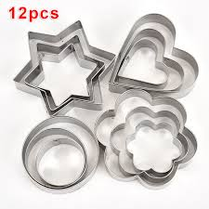
CUTTING TOOLS
Cookie Cutters – used to stamp out individual cookies from rolled dough.

Slide 23
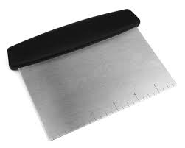
CUTTING TOOLS
Dough Cutter – used to cut dough during scaling.

Slide 24
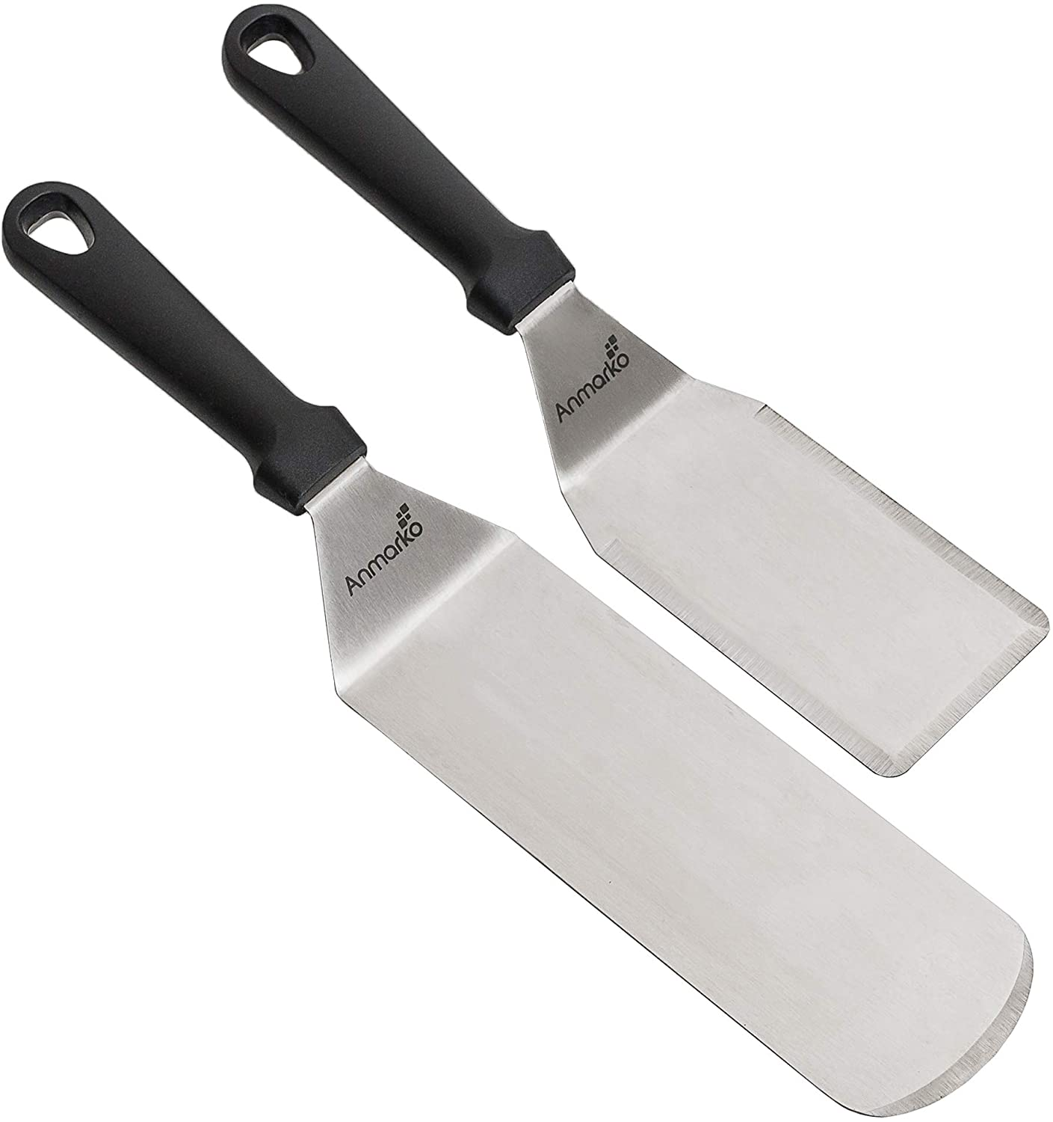
MISCELLANEOUS TOOLS
Metal Spatula – used for frosting cakes and used to loosed cookies from the pan

Slide 25
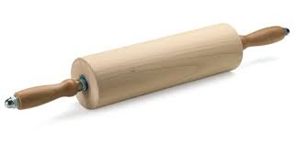
MISCELLANEOUS TOOLS
Rolling Pin – flattens or thin the dough or paste.

Slide 26
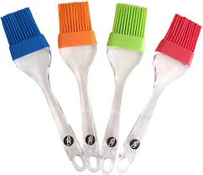
MISCELLANEOUS TOOLS
Pastry Brush – used for greasing pans, egg wash, and brushing of cake crumbs.

Slide 27
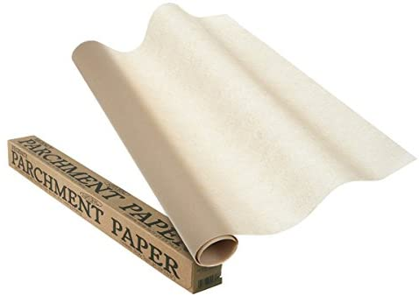
MISCELLANEOUS TOOLS
Parchment Paper – used as lining baking pans and piping cones for décor work.

Slide 28
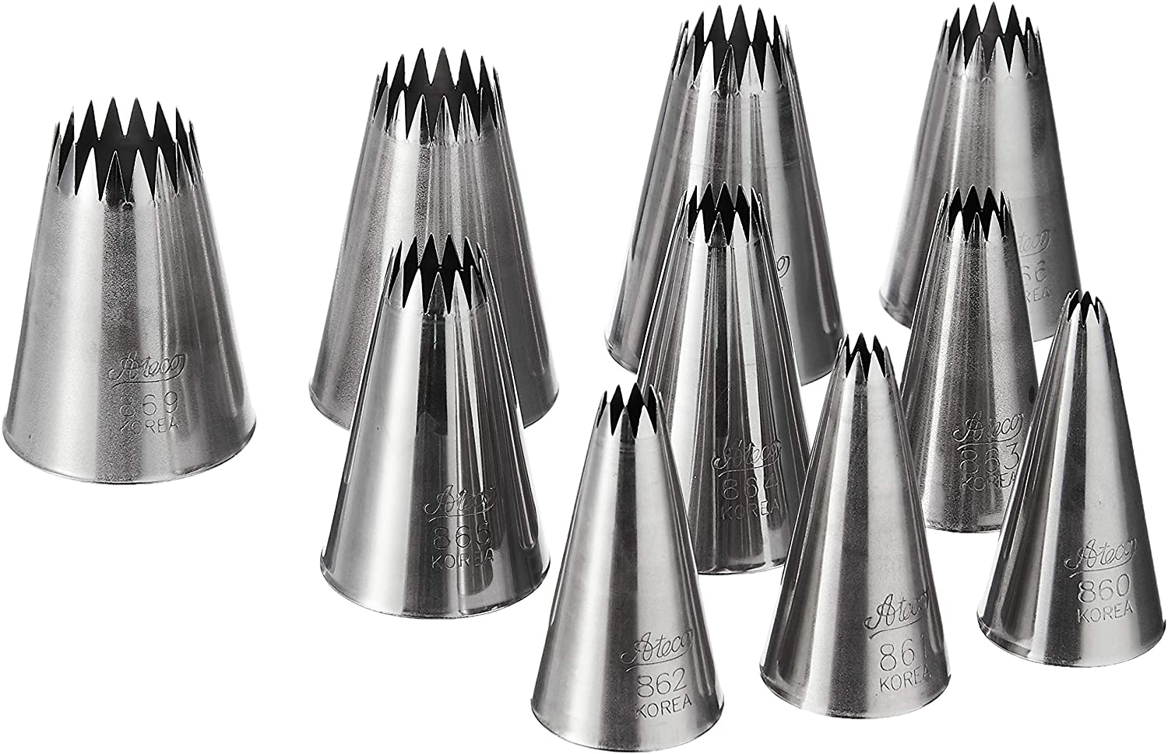
DECORATING TOOLS
Pastry Tips/ Piping Tubes – used to decorate in order to achieve the desired design.

Slide 29
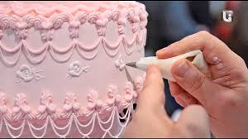
DECORATING TOOLS
Cake Decorator – used in decorating and designing cake and other pastry product.

Slide 30
BAKING EQUIPMENTS
Oven
Bread Toaster
Electric Mixer

Slide 31
Activity # 2.1
Search and list down any baking tools and equipment found in your place then picture. You need to label and write down the function of each baking tools and equipment then submit it through my gmail below.
rpaul_jhsfac@uspf.edu.ph

Slide 32
Thanks for listening….

